Slide 1
Analysis of Data Science Career
MSDS 597 Final Presentation
Jongsoo Han
Heon Park

Slide 2
Table of Contents
Introduction
Dataset
Exploratory Data Analysis
Summary

Slide 3
Introduction
With the increased demand on career opportunity for Data Scientist, we would explore this dataset in order to provide the readers with the understanding/overview of the data science career market.

Slide 4
Dataset
Variable Name | Detail
Job Title | Title of the data job
Salary Estimate | Range of salary and the source
Job description | Tells us what is expected out of the job title
Rating | The rating of the company
Company Name | Name of the company
Location | Location of the job
Headquarters | location of headquarter of the company
Size | Range of number of employee working in the company
Founded | Company founded in Year
Type of Ownership | Tells us if the company is private, public or government owned
Industry | Industry of the company
Sector | Sector in which company works
Revenue | Total revenue of the company per year
Competitors | Current competitor of the company in the same sector
Lower Salary | Lower salary reported for the job in a particular company
Upper Salary | Upper salary reported for the job in a particular company
Avg Salary (K) | Average of Lower and Upper salary yearly
Multiple Skill Columns | python, spark, aws, excel etc
Degree | If the job description mention that the company gives experience credit for a master(M) or Ph.D degree(P)
The dataset is available at Kaggle, and this dataset was extracted by scrapping the job postings related to the position of 'Data Scientist' from www.glassdoor.com.
The dataset contains information about the minimum salary, maximum salary, average salary, job description, age of the company in years, etc.
(https://www.kaggle.com/datasets/nikhilbhathi/data-scientist-salary-us-glassdoor)

Slide 5
Dataset
Data Pre-Processing
After scrapping the raw data, all duplicated rows were removed and, several simplifications were performed to make the data user friendly for further data analysis and modelling.
There is No Null Value
42 Columns
742 Rows

Slide 6
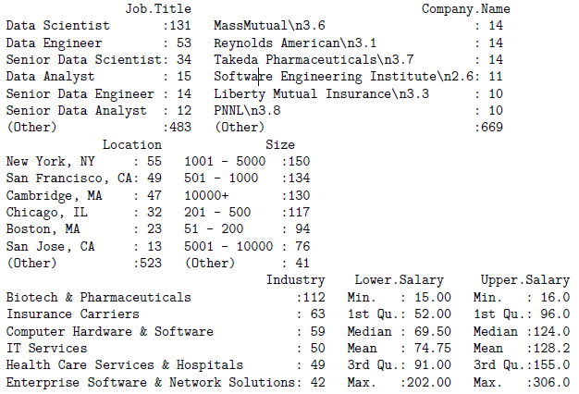
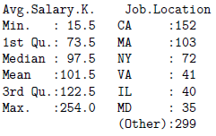
Exploratory Data Analysis
There 742 job postings related to Data Science.
Average Salary is $101.5K.

Slide 7
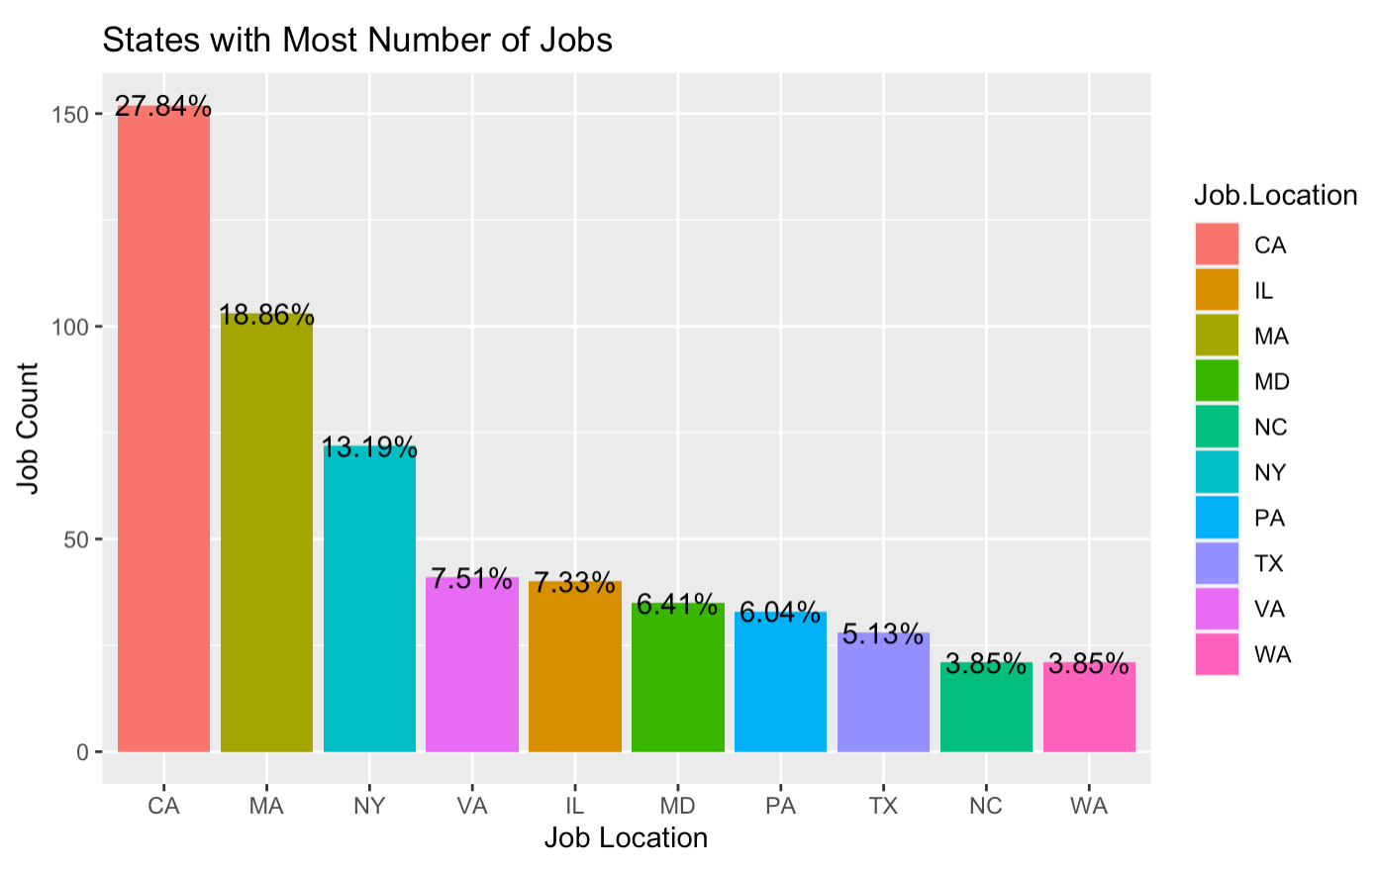
Exploratory Data Analysis
The Data shows California has the most number of jobs.
Evidently, California to has the most number of jobs as it is a hub for Tech. companies and has silicon valley.
We may expect some growth in next few years with tech companies migrating to the Pacific Northwest regions
California, Massachusetts, New York, Virginia together has around 50% jobs.
Interesting fact is that despite having the largest number of Fortune 500 companies HQ in New York, it is still on 3rd position.

Slide 8
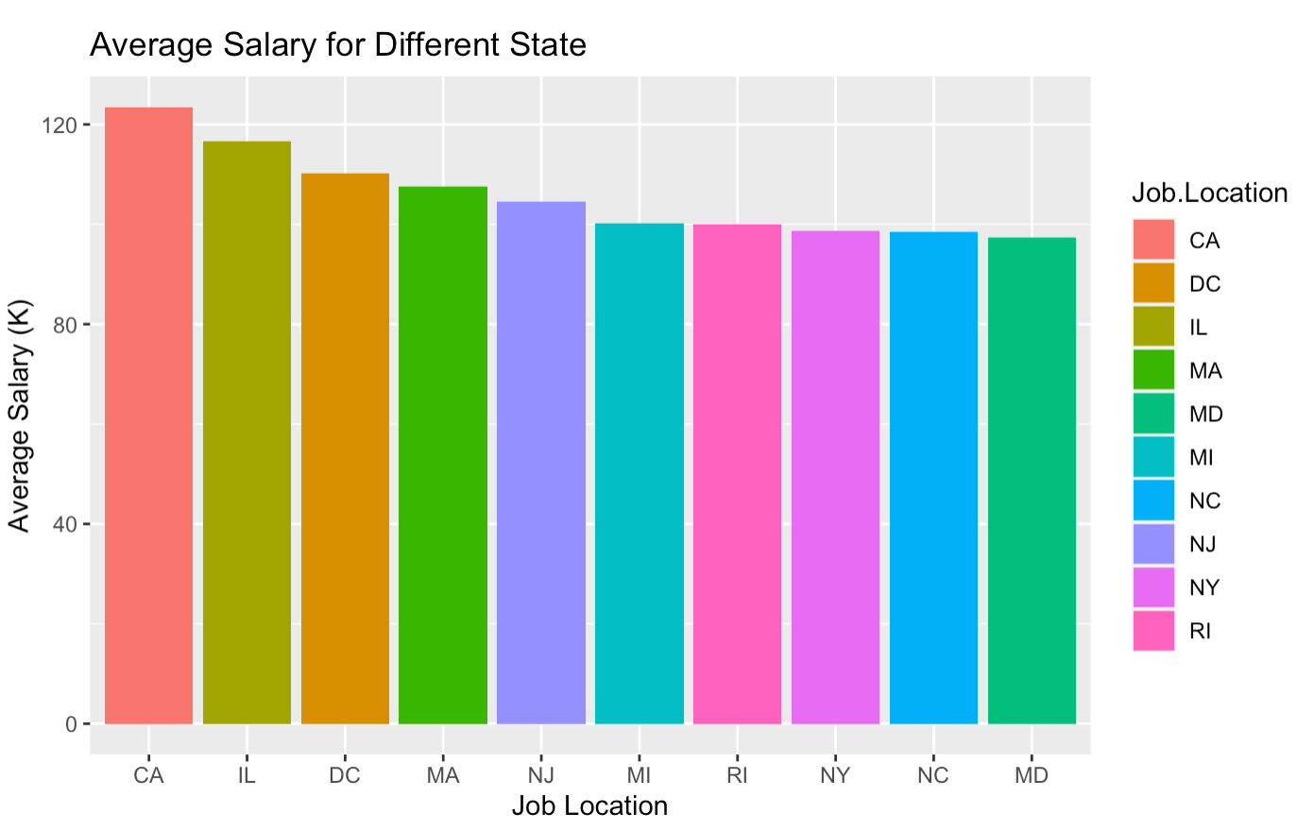
Exploratory Data Analysis
The graph shows average annual salary for different states.
State with highest number of job, California also offers the highest average annual salary, followed by Illinois.
Maryland has the lowest average annual salary.
It is interesting to find that NJ has higher average salary than that of NY. (NJ: 5th & NY: 8th)

Slide 9
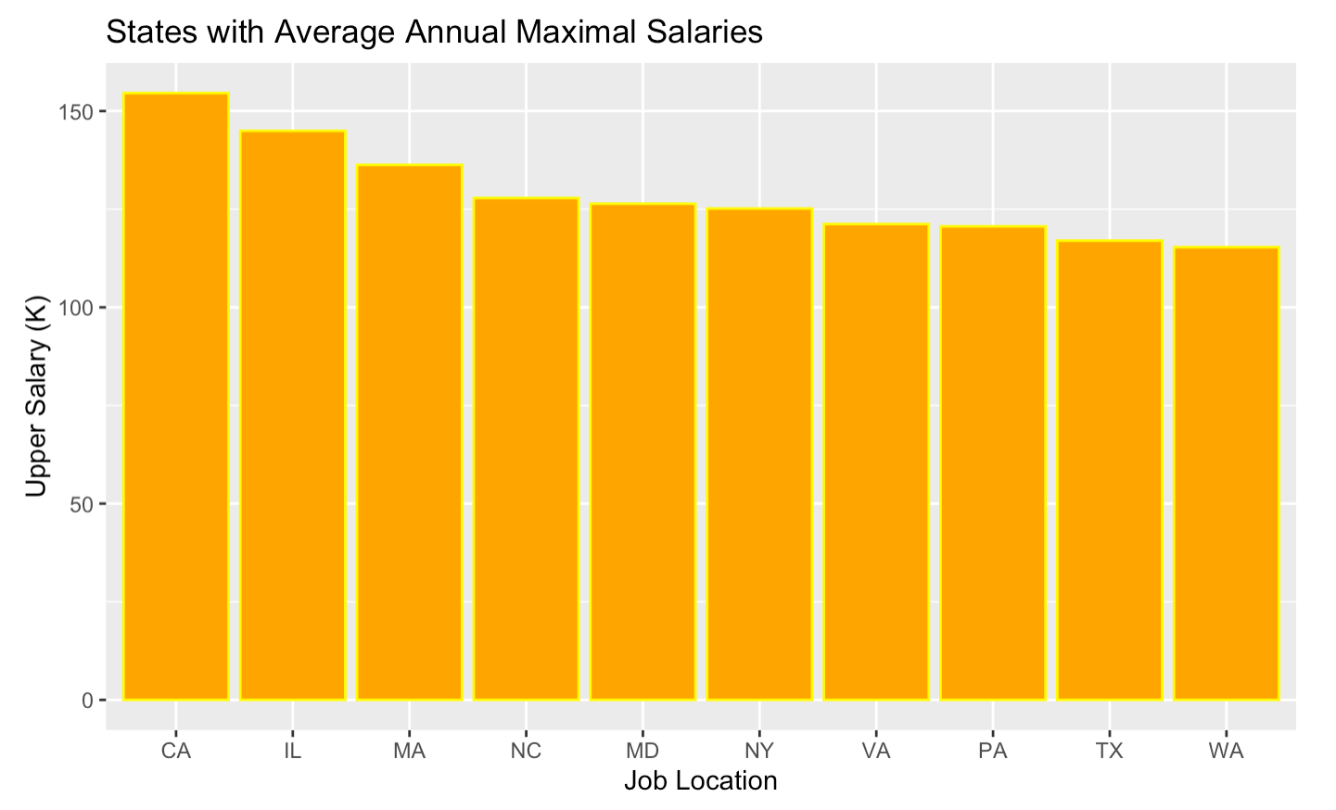
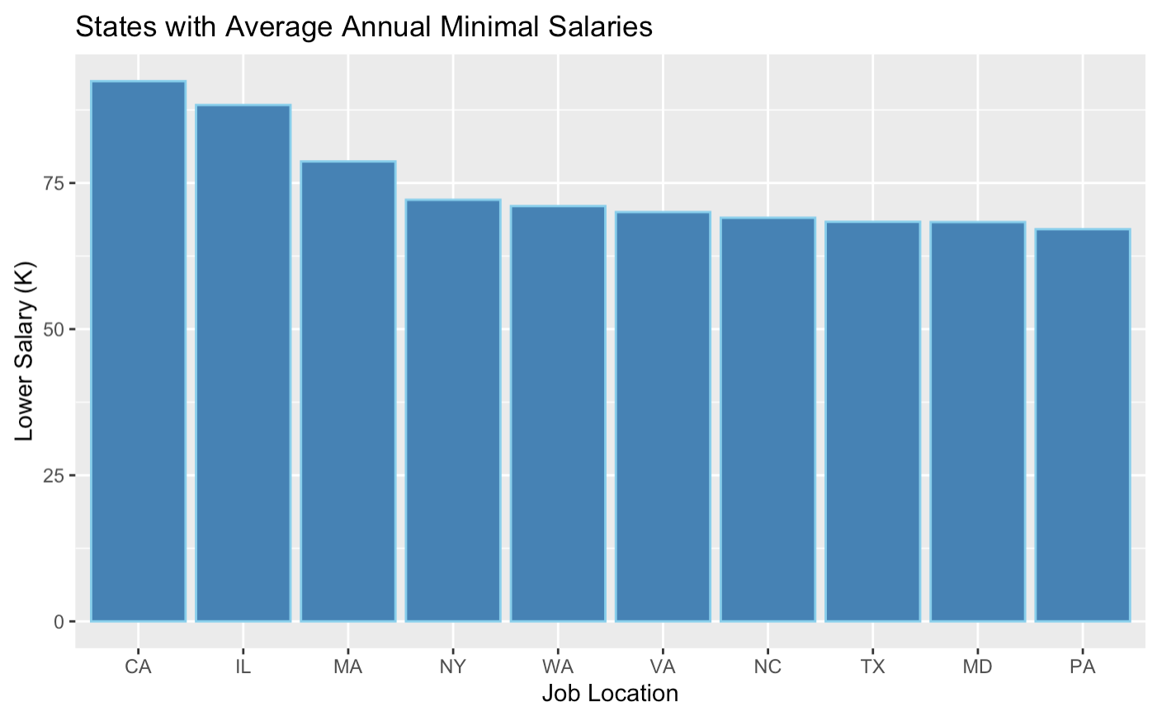
Exploratory Data Analysis
Sales with Annual Minimal Salaries:
-State with highest number of job, California also offers the highest average maximal annual salary, followed by Illinois.
-Washington has the lowest average maximum annual salary among the top 10 states.
Sales with Annual Maximum Salaries:
-We find that both California and Illinois has almost the same average minimal annual salary.
-we find that Pennsylvania has the lowest average minimum annual salary among the top 10 states.

Slide 10
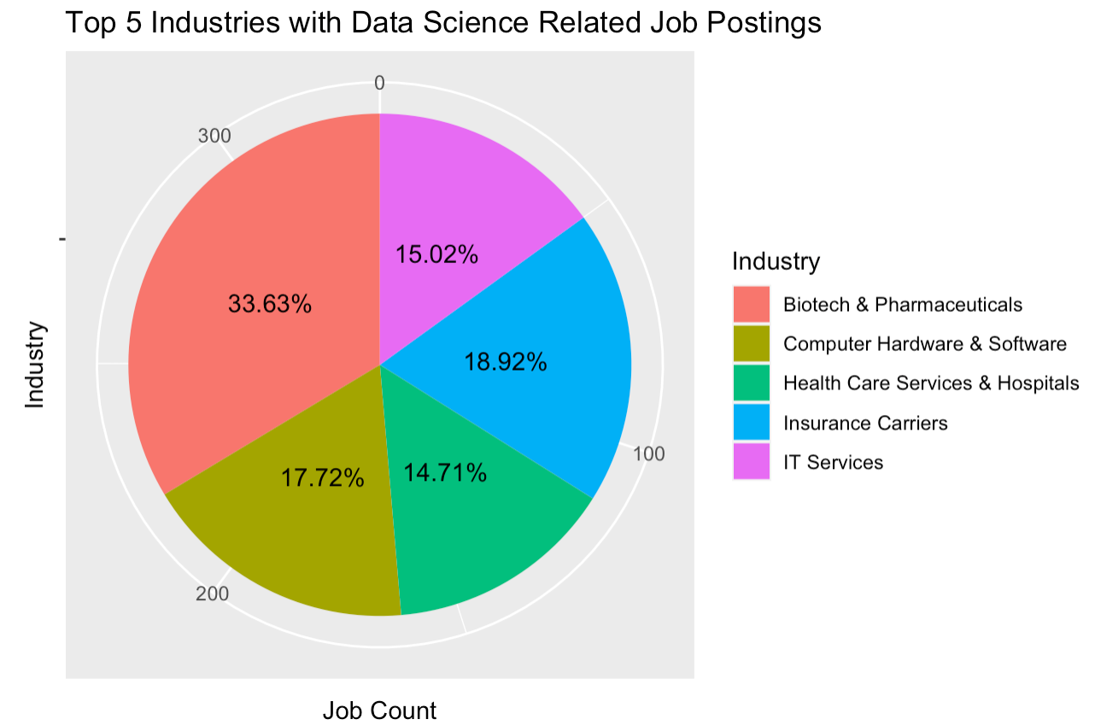
Exploratory Data Analysis
Biotech & Pharmaceuticals Industry has maximum number of jobs followed by Insurance carriers.
IT industry has fewer jobs for data science related roles.
More than 65% data science related jobs lie in top 10 industries.
For this dataset, Biotech & Pharmaceuticals Industry has twice the amount of jobs compared to IT services industry.

Slide 11
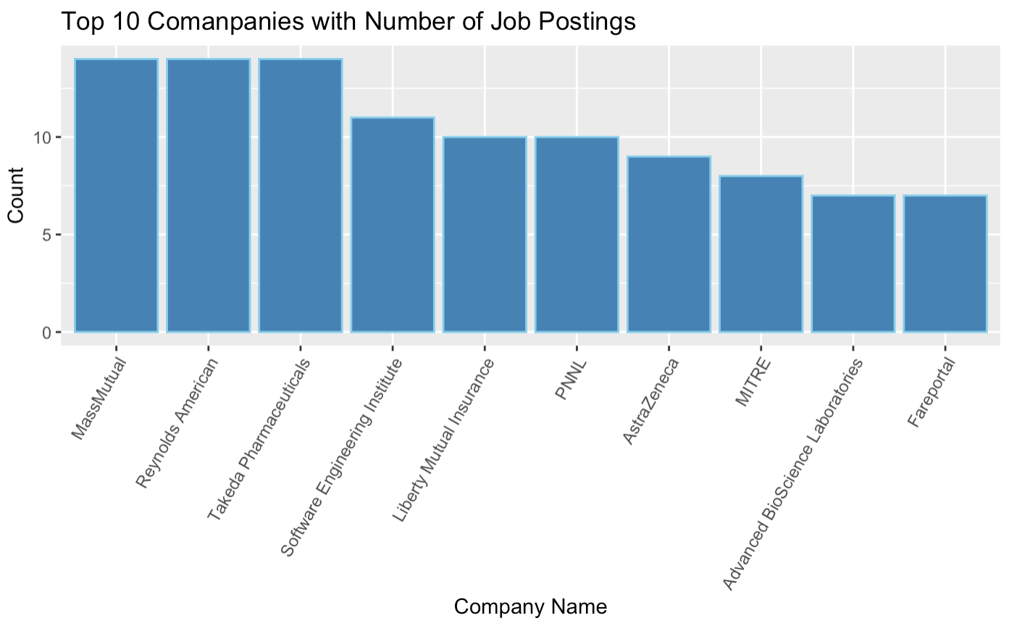
Exploratory Data Analysis
There are total 342 companies in the dataset. This is why there is less number of job postings by each company.
Reynolds American, MassMutrual and Takeda Pharmaceuticals company tops the list with 14 job postings related to data science.
We find that a Pharmaceutical Industry is leading with the most number of job postings, we see the same trend here as well

Slide 12
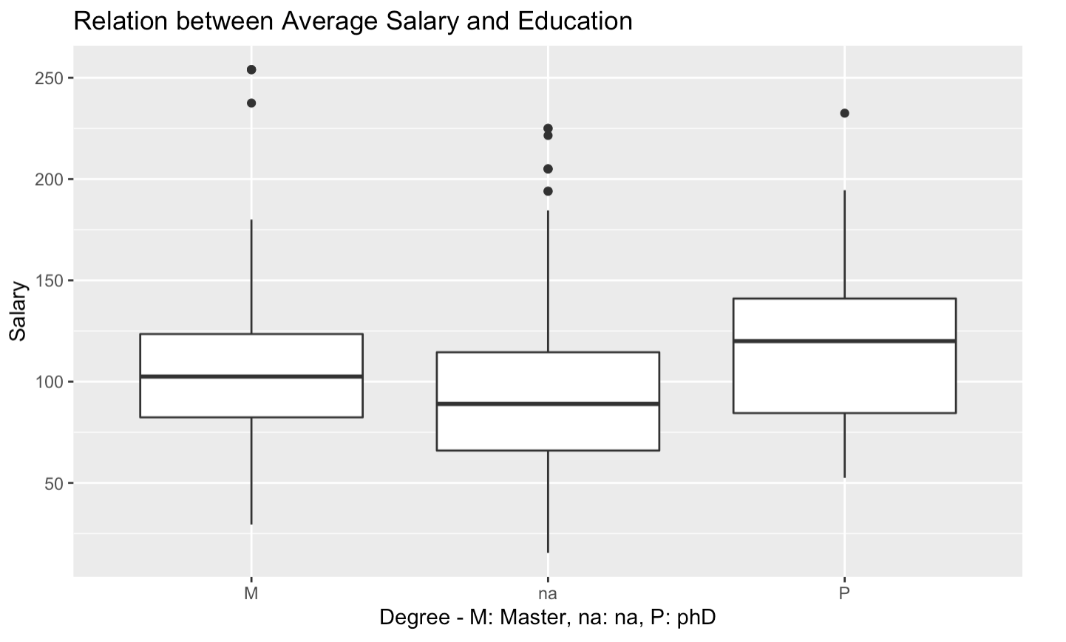
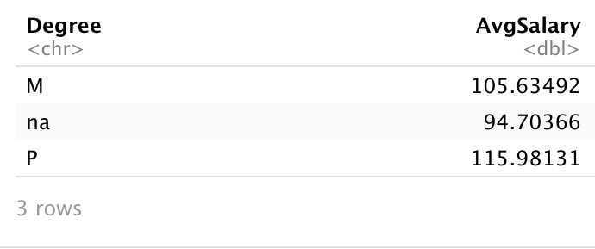
Exploratory Data Analysis
Most of the companies has mentioned Masters degree in their job descriptions.
For companies that mentioned a PhD degree in their job description, they offered much highest average annual salary as compared to Masters.

Slide 13
Summary
We were able to find many interesting results from this analysis such as which state’s average salary is highest and lowest, and also which industry have most job posting related to Data Science.
One interesting issue that was quite surprising is that we found no correlation between company size/revenue and salary. It seems that salary is more correlated to a specific geography and degree.
Having conducted this analytical review of the datasets from Glassdoor, we were able to examine one of the most importing decisioning factor in job requisitions which is the salary.
We also could correlate this analysis to the expectations of the company from a data science employee.
As prospective candidates in Data Science industry, This project exercise has helped us to gain understanding around the various components in the current job market.

Slide 14
Thank you

